Slide 1
What is AI? AI is when computers can think, learn, and act like humans. AI means teaching computers to act smart. Just like we humans learn from experience, AI learns from data. For example, if you upload many photos of cats, AI learns how cat looks like, and next time it can recognize a cat by itself.“

Slide 2
Fundamentals of AI
(Data, Algorithm, Learning, Decision, Automation).
1.Data – AI needs information to learn, like we need books to study
2.Algorithm – Step-by-step instructions that tell the computer how to learn from data.
3.Learning – AI improves itself using techniques like:
Machine Learning (learning patterns from data)
Deep Learning (using artificial neural networks like the human brain)

Slide 3
4.Decision Making – After learning, AI can make predictions or
decisions. Example: Netflix suggesting movies.
5.Automation – AI can perform tasks automatically without human help. Example: Chatbots answering customer questions.

Slide 4
Types of AI
1.Narrow AI – Can do only one specific task ,Most AI today is Narrow AI. Example: Siri, Google Translate.
2.General AI – Can think and learn like a human. Can do many different tasks, not just one. Still in research, not real yet.
Example (imagination): A robot that can study, cook, play cricket, and talk like a person.

Slide 5
3.Super AI
-Smarter than human,Can make its own decisions better than us.

Slide 6
Quick Activity (AI or Not AI?)
Washing machine timer (it just runs on time).
Calculator (It only calculates, no learning).
Google Translate (Learns from data).
Self-driving car

Slide 7
Conclusion
AI learns from data, uses algorithms, makes decisions, and works automatically. Today AI is narrow, in future it may become more powerful. AI is here not to replace us, but to help us

Slide 8
Data types
Structure data
Data organize in rows and columns, like Excel or Database, because it will be easy to read machine, or we can search easy.
Example, student record, name, roll number, age, marks, employee details.

Slide 9
Unstructured Data
Data has no format, so it's hard to search and analyze to computer. It can be text, image, audio,
example of social media posts, photos on your phone.

Slide 10
Semi-Structured Data
It is a combination of both, but it has some structure or tag to understand, It'll give tags or keys labeled to give some structure.
Ex. Emails (subject, sender = structured + body text = unstructured).

Slide 11
Common Methods of Machine Learning
Supervised learning
Unsupervised learning
Reinforcement learning

Slide 12
Supervised learning
Supervised learning is a type of machine learning where the model learns from labeled data (data with correct answers). It finds the relationship between input (X) and output (Y) to make predictions. The model is trained and tested on that data

Slide 13
Example
Input (Features) | Output (Label)
1000 sq. ft., 2 BHK | ₹40 Lakhs
1500 sq. ft., 3 BHK | ₹60 Lakhs
2000 sq. ft., 4 BHK | ₹80 Lakhs

Slide 14
Unsupervised Learning
Unsupervised learning is a type of machine learning where the model finds hidden patterns and deals with unlabeled data

Slide 15
Example
Grouping fruits by color, size, or shape without knowing their names — e.g., the model clusters apples, bananas, and oranges into groups automatically.

Slide 16
Reinforcement Learning
Reinforcement Learning is a type of AI where an agent learns from trial and error by receiving rewards or penalties for its actions.
Ex A robot learns to walk ✅ Gets reward when it moves correctly ❌ Gets penalty when it falls

Slide 17
Natural language processing
NLP is a branch of Artificial Intelligence that helps computers understand, interpret, and talk with humans in our natural language (like English, Hindi, etc.)
Machine Translation → “Good Morning” → “शुभ प्रभात”.
Speech Recognition → You say “Open YouTube”, computer converts speech → text → action

Slide 18
Generative Adversarial Network (GAN)
A GAN is a type of AI model that uses two neural networks — a Generator and a Discriminator — that compete with each other to create data that looks real.

Slide 19
Generative Adversarial Network (GAN)
How it works
Generator: Creates fake data (like images or sounds).
Discriminator: Checks if data is real or fake.
Both improve through competition, making results more realistic.

Slide 20
Generative Adversarial Network (GAN)
Example: A student (Generator) draws fake currency notes, and a teacher (Discriminator) checks if they’re real or fake. Over time, both get better!

Slide 21
Computer Vision
Computer Vision is a field of Artificial Intelligence (AI) that enables computers to see, understand, and interpret images and videos just like humans…

Slide 22
Computer Vision
How it works
A computer takes an image or video as input.
It analyzes shapes, colors, and patterns.
Then it understands what the image means — like identifying objects, faces, or actions.
Example:
Face unlock on your phone

Slide 23
Logistic Regression in Machine Learning
Logistic Regression is a supervised learning algorithm used for classification problems, where the output is categorical (e.g., Yes/No, 0/1) It predicts the probability of an event happening using a sigmoid (S-shaped) curve.

Slide 24
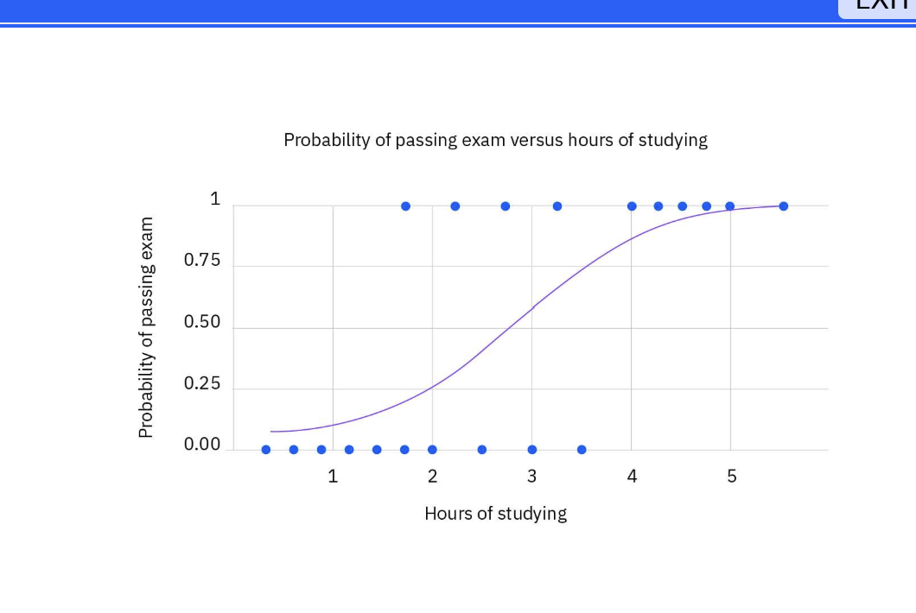

Slide 25
Deep Learning Ecosystem
Deep Learning is a subset of Machine Learning that uses neural networks with multiple layers to learn complex patterns from large amounts of data.

Slide 26
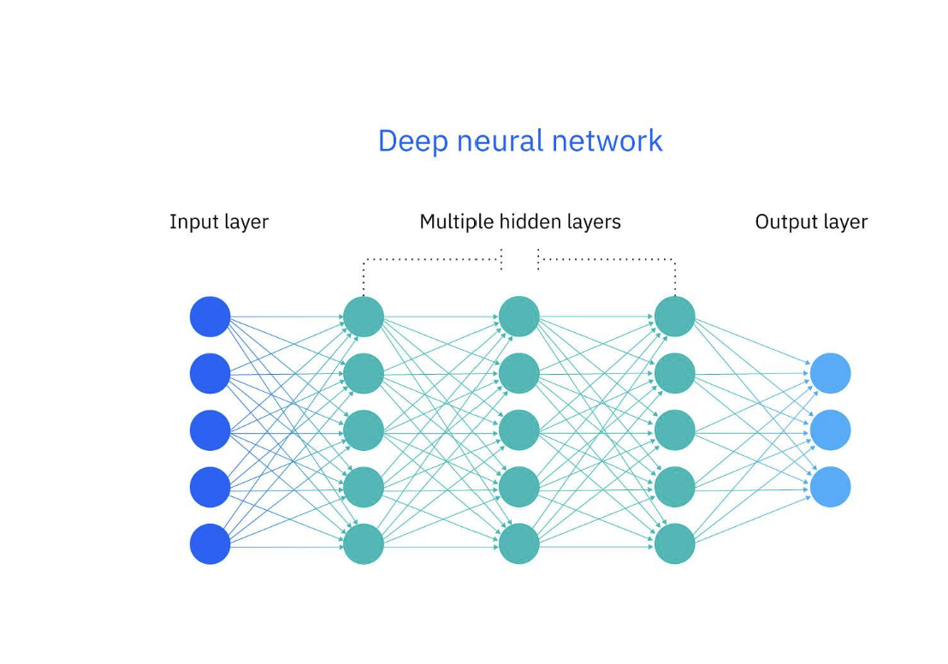

Slide 27
Input Layer
This layer receives the raw data (e.g., images, numbers, or features).
Each circle represents one input feature.

Slide 28
Hidden Layers
These are called hidden layers because they are not visible in the input or output.
Each layer processes the information and finds patterns or relationships
Output Layer
This layer gives the final prediction or result.

Slide 29
Limitations of Generative AI
Lack of Accuracy:
Generative AI sometimes gives wrong or misleading answers because it only predicts patterns — it doesn’t actually know facts. For example, it might write a story with incorrect historical details.

Slide 30
Limitations of Generative AI
No Real Understanding: AI doesn’t truly “think” or “understand” like humans. It just learns from examples. For instance, it can write a poem about love but doesn’t feel emotions.

Slide 31
Limitations of Generative AI
High Cost and Energy Use: Training and running AI models require powerful computers and a lot of energy, which makes it expensive and not very eco-friendly
Risk of Misinformation: AI can be used to make fake news, false images, or deepfake videos, which can easily mislead people

Slide 32
AI Ethics in Artificial Intelligence
AI Ethics means following moral rules and responsible behavior while creating and using Artificial Intelligence systems.It ensures that AI is used fairly, safely, and for the benefit of everyone not to harm or discriminate.
AI Ethics is about teaching machines to do the right thing — just like we teach people what is right or wrong.

Slide 33
Why AI Ethics is Important
AI can make powerful decisions — in health, jobs, education, or law. If not used properly, it can:
1.Make unfair decisions
2.Violate privacy
3.Cause harm to people or society

Slide 34
Why AI Ethics is Important
AI Ethics helps make sure that AI is: 1.Fair 2Transparent 3.Safe 4.Respectful of human values

Slide 35
Principles of AI Ethics
Fairness – AI should treat everyone equally. Example: An AI hiring system should not select only men for jobs
Privacy – AI should protect personal information. Example: Chatbots should not share your personal data.

Slide 36
Principles of AI Ethics
Accountability – Someone must take responsibility if AI makes a mistake. Example: A company is responsible if its AI spreads false news.
Human-Centered – AI should help people, not replace or harm them. Example: AI in healthcare should support doctors, not make unsafe decisions.

Slide 37
What is Robustness
Robustness means the ability of an AI system to stay strong and give correct results, even if something goes wrong or if it faces new or tricky data
Imagine an AI model trained to recognize cats in photos. If it can still correctly identify a cat even when the picture is blurry or dark — that means the model is robust.

Slide 38
Why Robustness Matters
-Ensures reliable results in the real world
-Makes AI systems trustworthy and safe
Ex. We want AI systems to be strong like a person who doesn’t get confused easily — that’s robustness

Slide 39
About this module
What robustness means in AI
Why it’s important for safe and fair AI systems
How to identify and fix weak points in AI models

Slide 40
Identify the issue
Where could an AI system fail?
Wrong predictions on new data
Misunderstanding due to noise or spelling mistakes
Overfitting to training data

Slide 41
What is Explainability
Explainability means understanding how an AI model reaches its result.
Explainability means we can understand what’s happening inside the AI — it’s not a mystery box

Slide 42
What is Transparency
Transparency means being open and clear about how an AI system works — what data it uses, who built it, and how it makes decisions.
Transparency means no secrets in AI everyone should know how it works

Slide 43
A transparent AI system clearly tells:
What data it used
Who trained it
Why it gave a certain result
If an AI recommends a product, it should say why — maybe because of your past purchases.”

Slide 44
Cyber Security
protecting computers, mobile phones, networks, and data
from unauthorized access.

Slide 45
Why is Cyber Security Important?
1.Protects personal data
--Aadhaar, passwords, bank details
2.Prevents financial loss
--Online fraud. otp scan

Slide 46
3.Protects organizations – Company data, customer information
4.Maintains trust and safety
--Safe online transactions and communication

Slide 47
1.Network Security
Network security protects computer networks and internet
connections from unauthorized access and cyber attacks
Example: A firewall blocking hackers from accessing an office Wi-Fi network.

Slide 48
2️⃣ Application Security
Application security protects software and mobile applications from vulnerabilities and cyber threats.
Example: Secure login and regular updates in a banking mobile app.

Slide 49
3️⃣ Information (Data) Security
Information security protects sensitive data such as passwords, personal details,
and confidential files.
Example: Encrypting important documents and customer data.

Slide 50
4️⃣ Endpoint Security
Endpoint security protects devices like laptops, mobile phones, and desktops
from malware and viruses.
Example:Antivirus software installed on a laptop.

Slide 51
5️⃣ Cloud Security
Cloud security protects data and services stored on cloud platforms
Example: Protecting files stored in Google Drive with secure access controls.

Slide 52
6️⃣ Identity & Access Management (IAM)
IAM ensures that only authorized users can access systems and data using authentication methods.
Example: Logging into an account using a password and OTP

